Slide 1

Patient Monitoring System - PMS
Nikolaos Karapoulatidis
Electronic Engineering, Hochschule Hamm-Lippstadt, Marker Allee 76-78, 59063 Hamm

Slide 2
Target group – Patient characteristics
The PMS is tailor-made for older people which suffer of diabetes and/or high blood pressure
Type 2 diabetes results from the body’s ineffective use of insulin - 95 percent have type 2 diabetes
constant hunger, weight loss, vision changes, and fatigue may occur suddenly

Slide 3
Patient needs based on personas
Affected people are worried about that diabetes will control their life
Afraid of missing a worthy life because they always need to pay attention on their insulin levels
Many people also do not have the time to go frequently to the doctor
Data tracking for more differentiated diagnosis

Slide 4
OVERVIEW OF THE CONCEPT
The PMS is portable and stationary usable
if used portable a power saving mode is activated to increase battery life -> will deactivate the data transmission
back-light of the screen is adjusted depending on the ambient light
touch display for visualizing data and for entering parameters
loudspeaker should mainly act as an alarm
sensing the pulse, blood pressure, glucose levels and temperature
data is transmitted via WiFi into a cloud
interface for an insulin pump

Slide 5
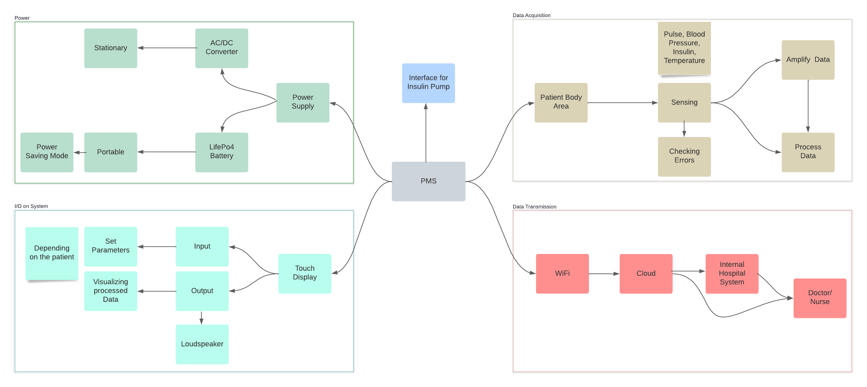

Slide 6
Important requirements
Security for Personal Data - cryptographic functions are needed to protect data transferred to, from, or stored within the personal healthcare monitor
Power Efficiency - the active time of high-power functions should be minimized as much as possible
Comfort - not too big or heavy in order to not restrict the patient in any ways, big enough screen so that also old people can read the information and battery should last long enough

Slide 7
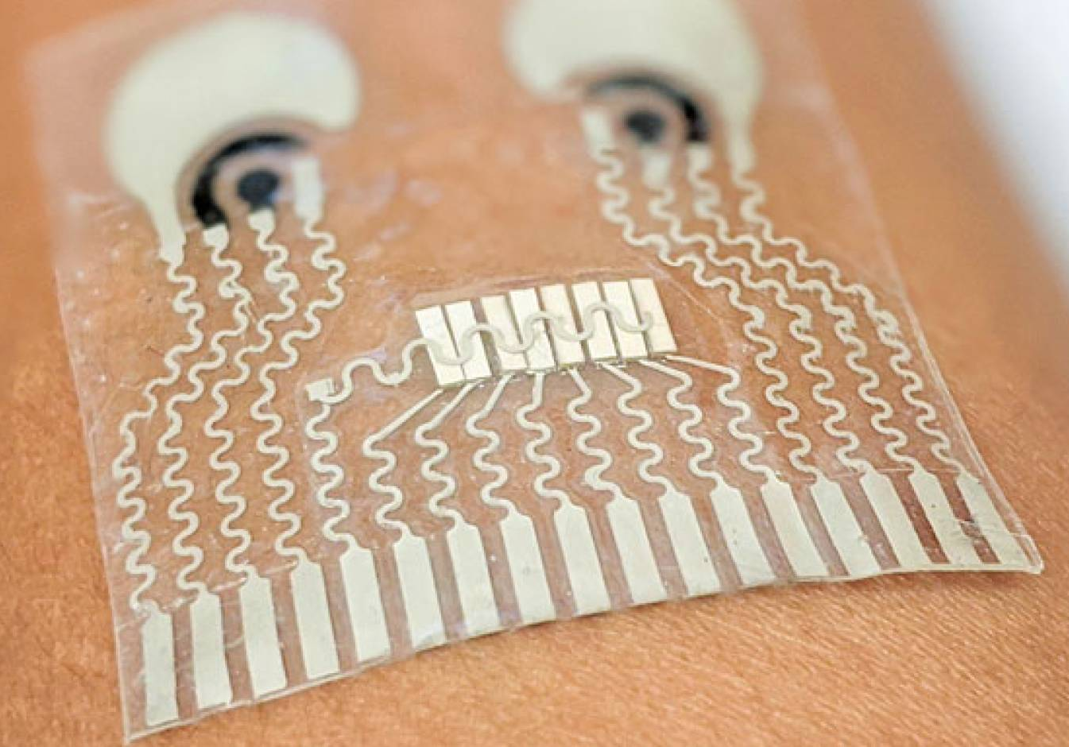
Hardware for sensing vital parameters
soft, stretchy skin patch that can be worn on the neck to continuously track blood pressure and heart rate
developed by engineers at the University of California
great comfort compared to individual sensors distributed on the body
Photoresistor for detection of the intensity of the ambient light

Slide 8
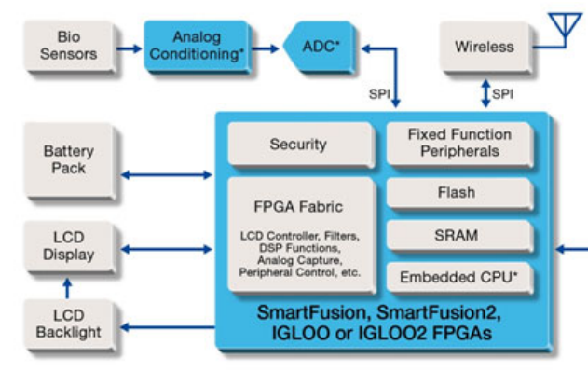
Processing units
SoC from Microsemi called „Smart Fusion“
FPGAs are cheap, very fast with custom programming, flexible and reprogrammable after installation

Slide 9
Power supply
Common AC/DC chargers for smartphones with enough power
Battery chemistry type is LiFePO4 since it is one of the safest battery types - very good energy to weight ratio and lifetime
For cell balancing and protection a suitable battery management system is needed

Slide 10
Data Transmission and Storage
low power WiFi module - Sterling-LWB+ with fully featured WiFi 4
easy integration with any Linux or Android based system
In order to map the data to the belonging patient a unique ID is provided
hard disk is used to store data locally on the device

Slide 11
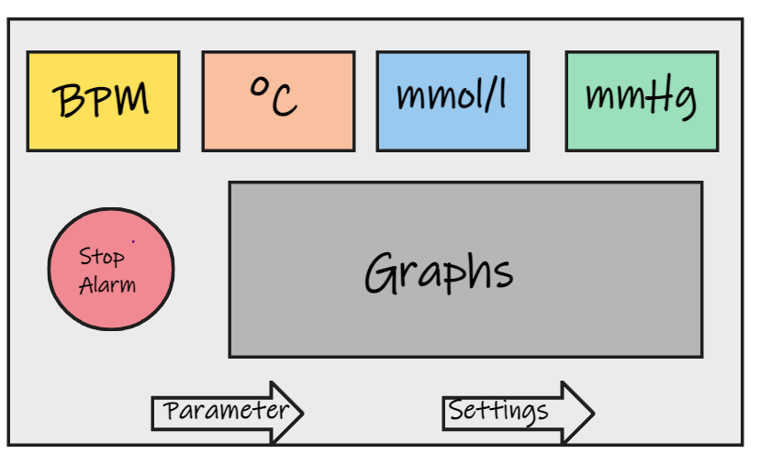
User Interface
LCD-Touch-Panel - 7inch with a 16:9 ratio - low cost and good power efficiency
big text-boxes in different colors for each parameter (Glucose Level, Blood Pressure, Temperature, Pulse Frequency) updates every 5 seconds
graphs with different colors matching them of the text boxes show the history of the parameters (same page or on a second page)
If a parameter reaches an abnormal value, the corresponding text box will start blinking
patient can change the size and position of different text-boxes
In case of a false alarm because a sensor is not working properly or external interference, the patient can turn of the alarm

Slide 12
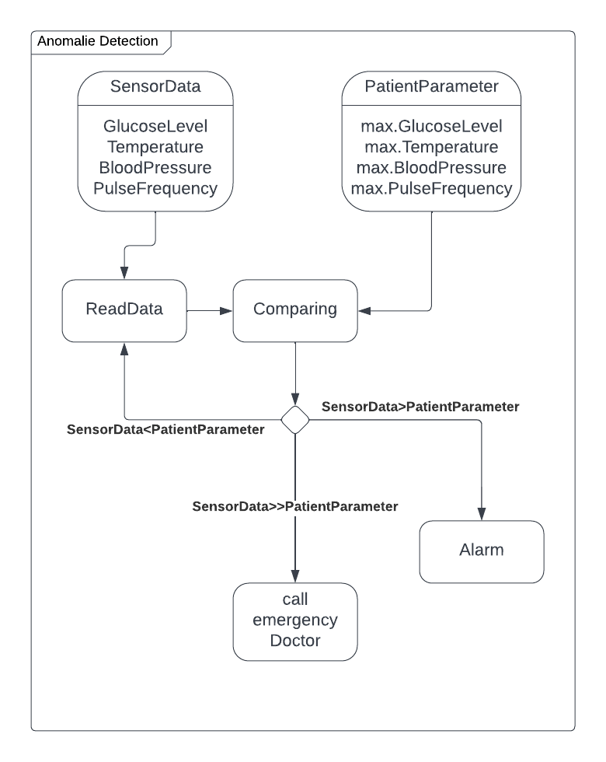
Alarming for Vital Scenarios
Unique alarm sounds if a parameter is reaching a level which is threatening
For the case that a parameter is way higher or lower than the reference parameter so that it could be life threatening the PMS will spell the words ”call an emergency doctor”
Also advises on how to help the patient as a normal person are shown on the display

Slide 13
Discussion and conclusion
complexity of such a system is huge
to develop a market ready PMS a team of electrical, electronic and software engineers must work closely together
long and intense testing phase since the data it shows must be very reliable
PMS has a very minimalistic though sufficient UI which can be personalized
PMS consists of several alarm mechanisms
interface for connecting an Insulin Pump which can actively control the glucose level of the blood

Slide 14
References
[1] M. Engelgau, S. Rosenhouse, S. El-Saharty, and A. Mahal, “The economic effect of noncommunicable diseases on households and nations: a review of existing evidence,” Journal of health communication, vol. 16, no. sup2, pp. 75–81, 2011.
[2] P. Zhang, X. Zhang, J. Brown, D. Vistisen, R. Sicree, J. Shaw, and G. Nichols, “Global healthcare expenditure on diabetes for 2010 and 2030,” Diabetes research and clinical practice, vol. 87, no. 3, pp. 293– 301, 2010.
[3] “Diabetes who,” Available at https://www.who.int/healthtopics/diabetestab=tab1(15/06/2022).
[4] L. Labios, “New skin patch brings us closer to wearable, all-in-one health monitor,” Available at https://www.universityofcalifornia.edu/news/new-skinpatch-brings-us-closer-wearable-all-one-health-monitor (29/05/2022).
[5] “Smartfusion,” Available at https://www.microsemi.com/productdirectory/soc-fpgas/1693-smartfusion (15/06/2022).
[6] “3 essential lifepo4 battery features that promote product safety,” Available at https://relionbattery.com/blog/3-essential-lifepo4-battery-features-thatpromote-product-safety (28/02/2016). [7] “Lithium iron phosphate battery,” Available at https://en.wikipedia.org/wiki/Lithium iron phosphate battery(15 /06 /2022) .

Slide 15
Thanks for your attention!

